Slide 1
Digital Image Processing CSC331
Introduction

Slide 2
My Introduction
Dr. Asad Ali Safi
Assistant Professor
COMSATS Islamabad Pakistan
www.cvprg.org
EDUCATION
2008 - 2012 | Technical University of Munich, Germany
 | Ph.D. Major: Machine learning (Distinction)

Slide 3
Course Description
CSC331– Digital Image Processing
Number of Credit Hours: 3 credits
Catalog Description:
This course covers the fundamental concepts related to digital images and their processing. Topics covered include image processing fundamentals, image pre-processing, image segmentation, image compression, image representation, image description and object recognition.

Slide 4
Definition
Processing of images which are Digital in nature by digital Computers.

Slide 5
Why do we need to image processing ?
Motivation by three major applications
Improvement of pictorial information for human perception
Image processing for autonomous machine applications
Efficient storage and transmission

Slide 6
Human Perception
Methods for enhancing pictorial information for human interpretation and analysis
Common applications are
Noise filtering
Content enhancement
Contrast
De-blurring
Remote sensing

Slide 7
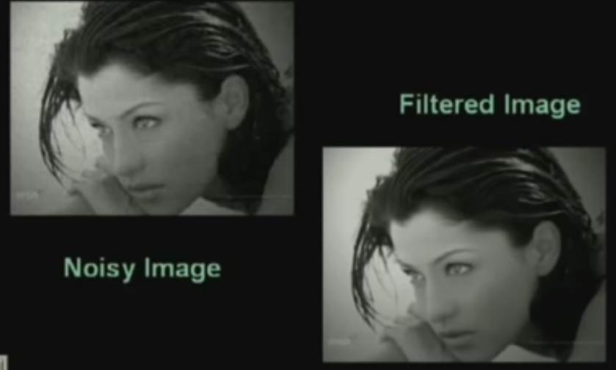
Noise Filtering

Slide 8
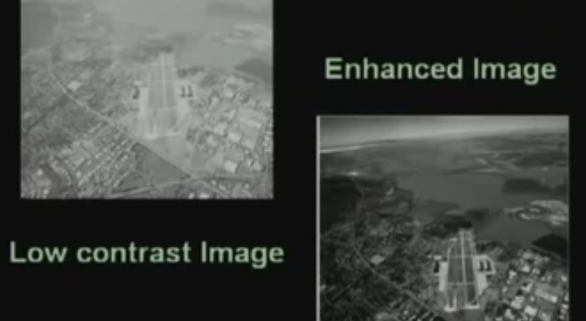
Contrast enhancement

Slide 9
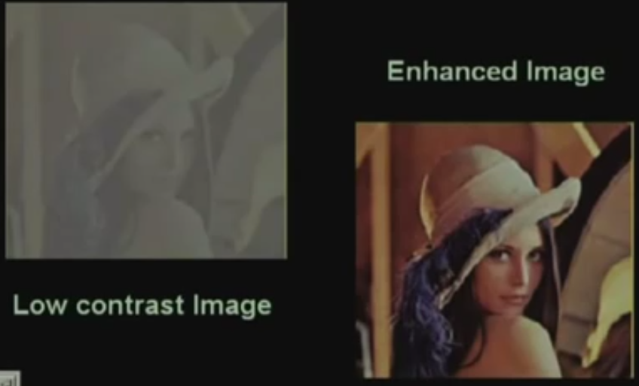
Contrast enhancement

Slide 10
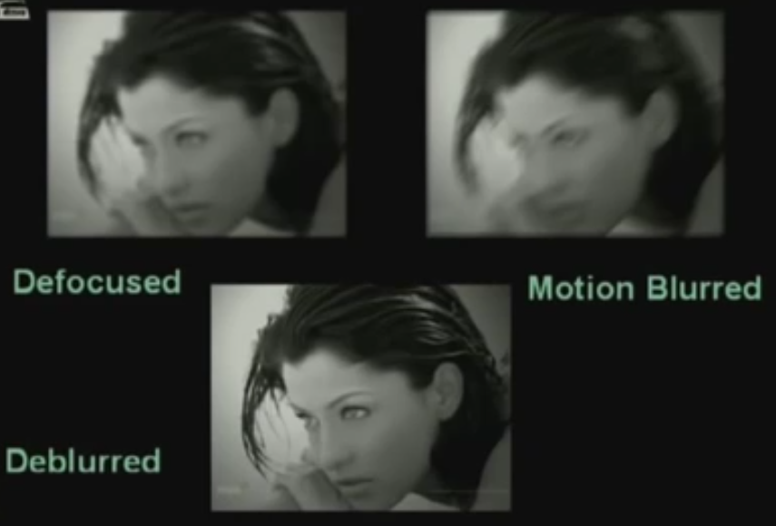
De-blurring

Slide 11
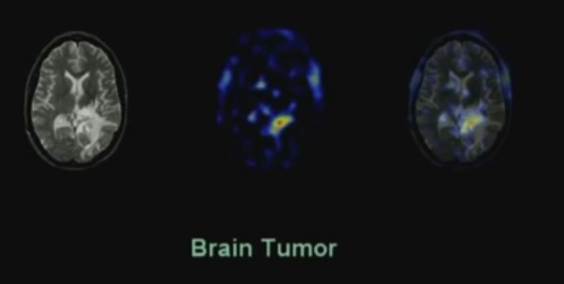
Medical Imaging

Slide 12
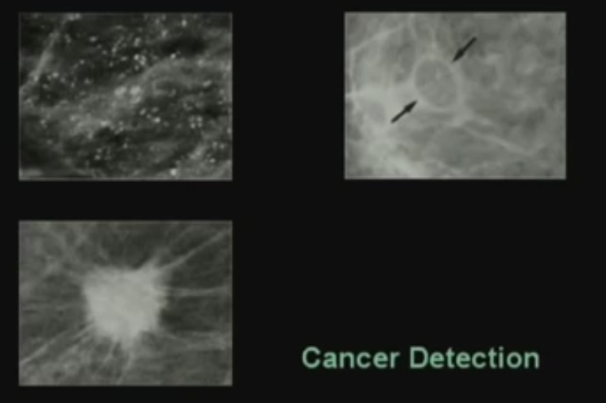
Medical Imaging

Slide 13
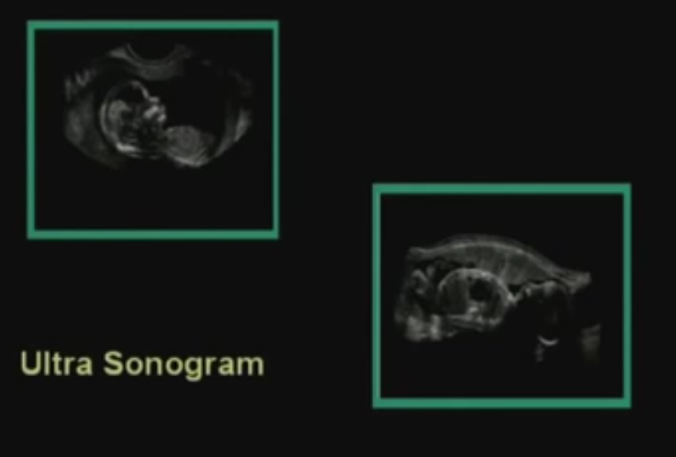
Medical Imaging

Slide 14
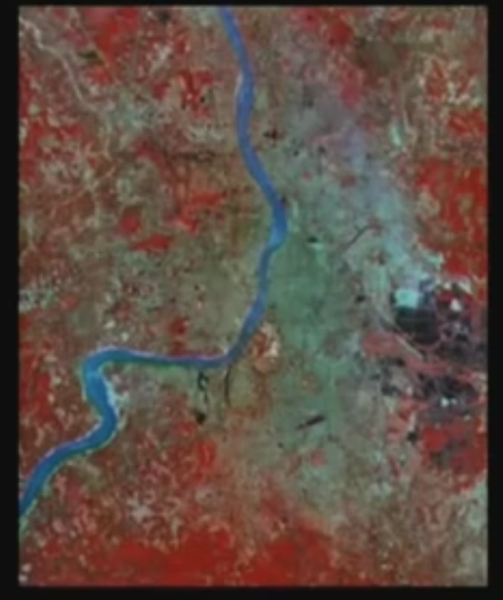
Remote Sensing

Slide 15
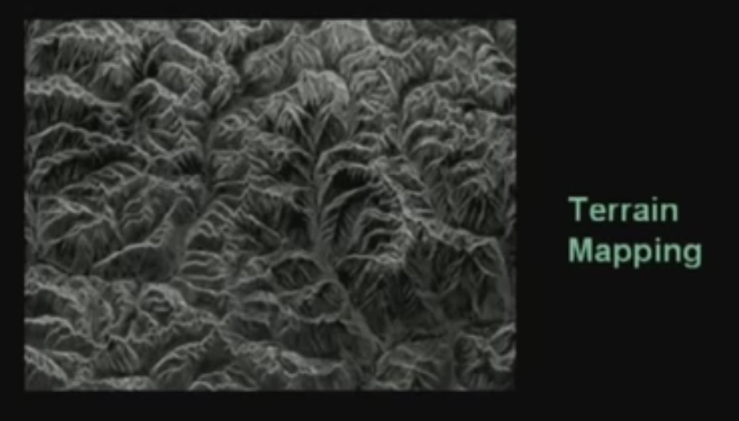
Remote Sensing

Slide 16
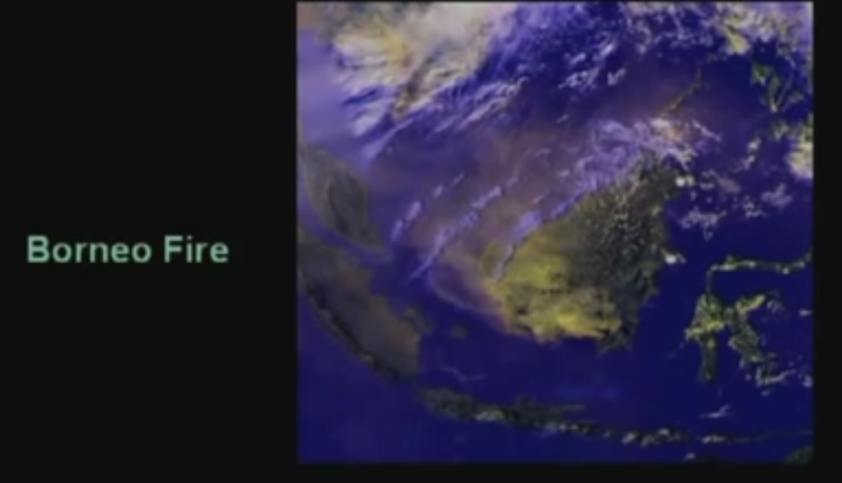
Remote Sensing

Slide 17
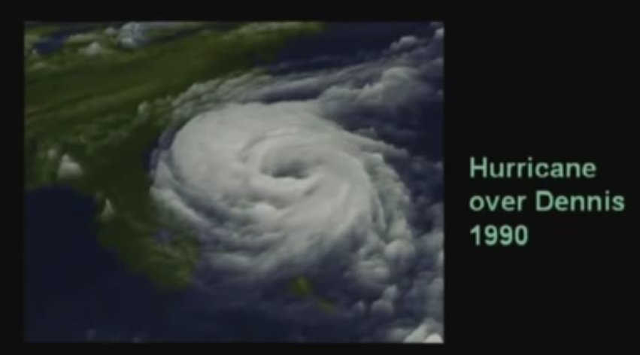
Weather Forecasting

Slide 18
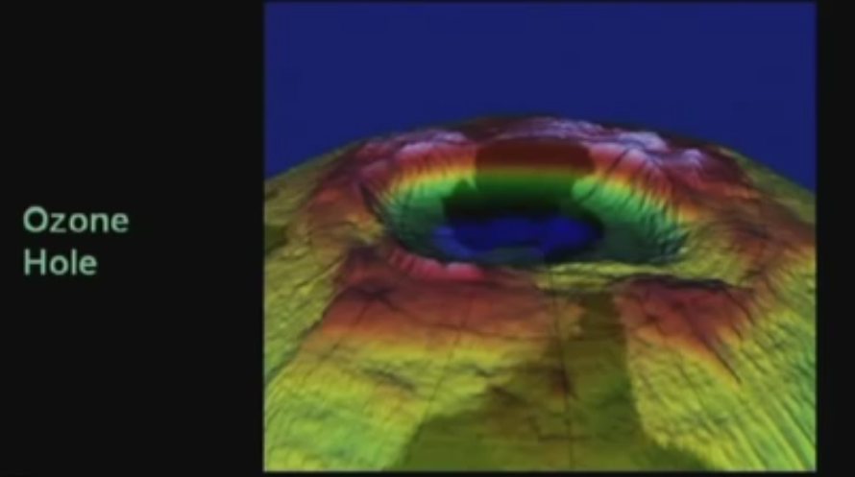
Atmospheric study

Slide 19
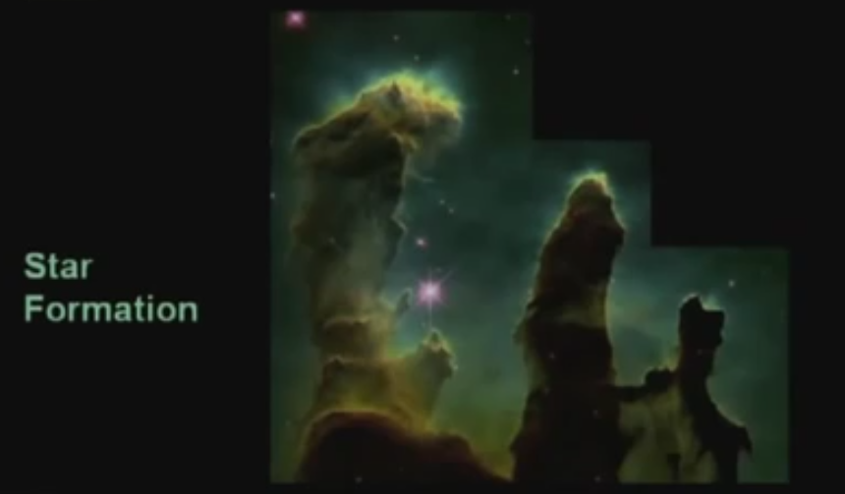
Astronomy

Slide 20
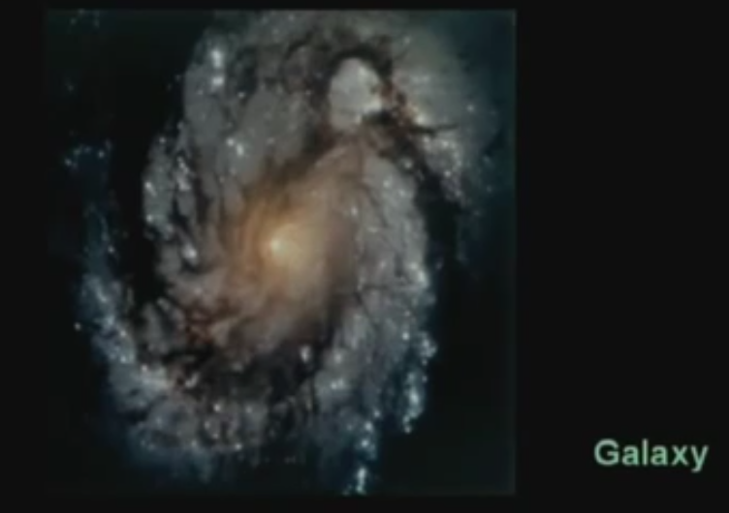
Astronomy

Slide 21
Machine vision applications
Extract the image information for further computer processing
Common applications are:
Industrial machine vision for product assembly and inspection
Automated target detection and tracking
Finger print recognition
Machine processing of aerial and satellite imagery for weather prediction and crop assessment

Slide 22
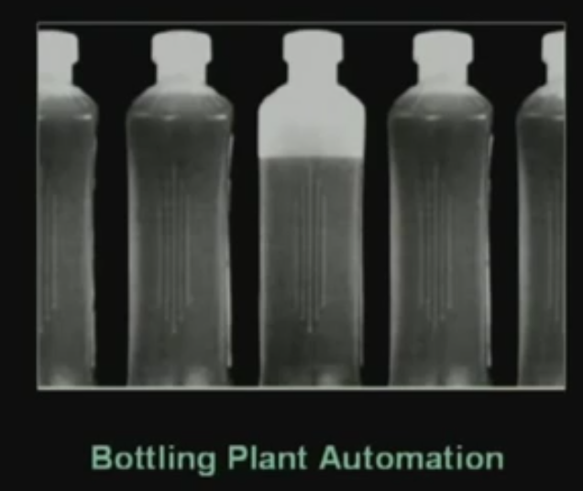
Automated inspection

Slide 23
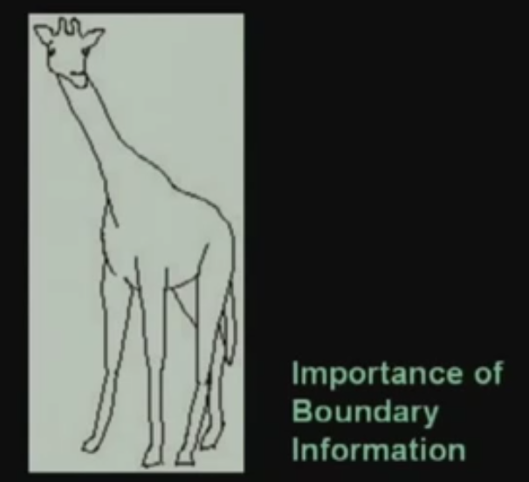
Boundary Information

Slide 24
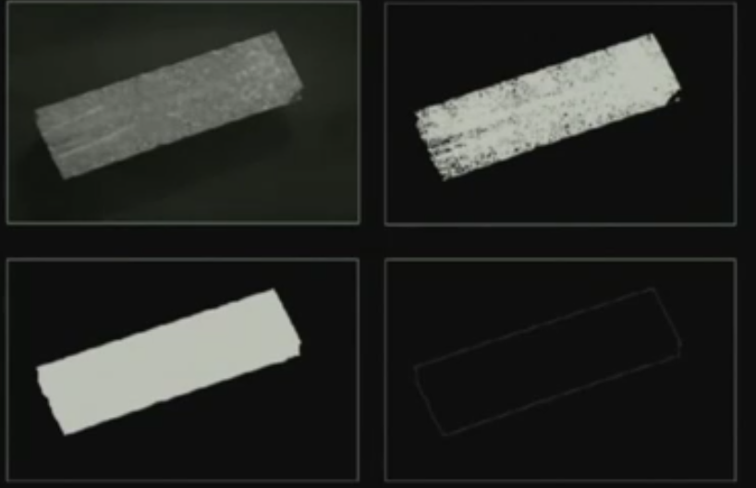
Automated inspection

Slide 25
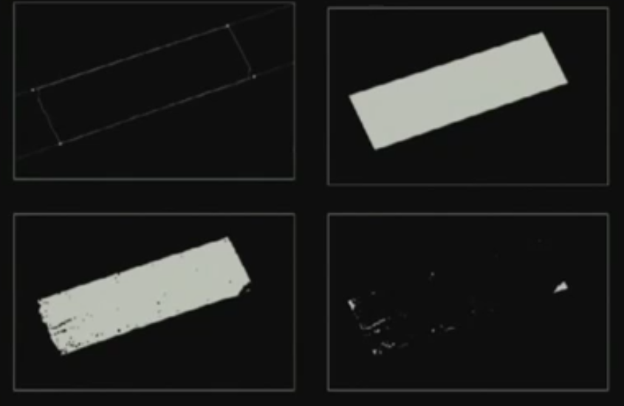
Automated inspection

Slide 26
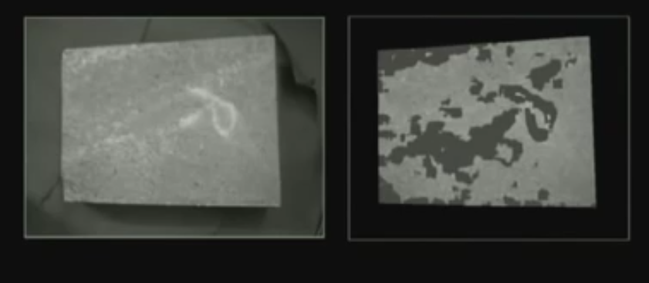
Surface information

Slide 27
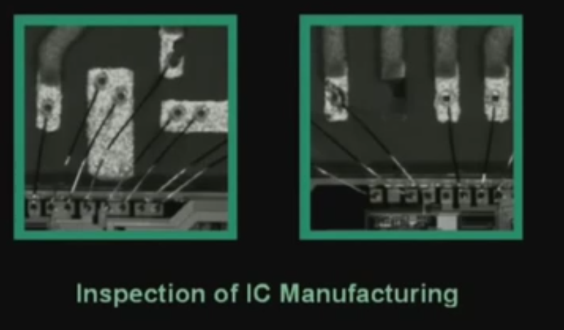
Automated inspection

Slide 28
Video sequence processing
To detect moving objects in image sequence for further processing
Some applications are
Detection and tracking of moving targets for security surveillance
Finding the trajectory of moving targets
Monitoring the movements of organ boundaries in medical applications

Slide 29

Moment detection

Slide 30
Moment detection

Slide 31
Tracking

Slide 32
Application
By single camera tracking
Find out what is the Azimuth and elevation of that particular object with respect to certain difference coordinate system.
By 2 different cameras tracking
Azimuth and elevation + can identify X Y Z coordinate of that object with respect to that 3 D coordinate system
locating those locations in different frames, we can find out that over the time which path the object is following
also we can determine that what is the trajectory that the moving object follows

Slide 33
Image Formats
Compression
An image contains redundant information which can be exploited for achieving compression
Three types of redundancy
The first kind of redundancy is called a pixel redundancy
The second kind of redundancy is called a coding redundancy
Third kind of redundancy is called a psycho visual redundancy.

Slide 34
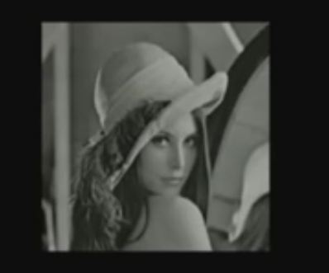
Pixel redundancy

Slide 35
Applications
Storage space reduction
Bandwidth reduction

Slide 36
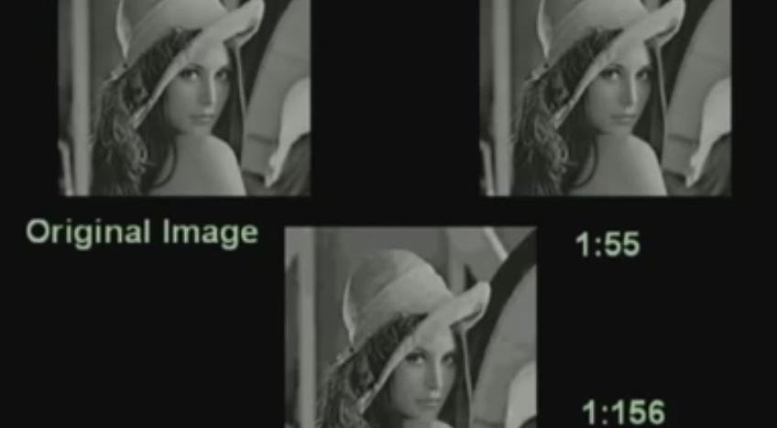
Compression

Slide 37
Lossy compression
Remove redundancy as will as also remove some of the information so that after removing those information, the quality of the reconstructed image is still acceptable
There will be some loss or some distortion and this is taken care by what is called rate distortion theorem.

Slide 38
Compare the space according to compression
Compare the space requirement of these 3 images;
If the original image is of size say 256 by 256 bytes that is 64 kilobytes,
The second image which is compressed 55 times, the second image will take slightly above something around say 10 kilobytes.
The third one will take something around 500 bytes or even less than 500 bytes.

Slide 39
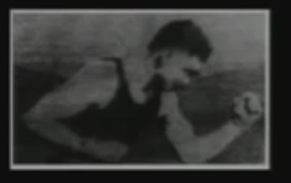
Brief History
In fact, as early as 1920’s, image processing techniques were been used
The image processing techniques or the digital images were used to transmit the news paper pictures between London and New York and these digital pictures were carried by submarine cables: the systems which was known as Bartlane systems.

Slide 40
Brief History..
when you transmit these digital images via submarine cable;
On the transmitting side,
A facility for digitization of the image.
On the receiving side,
A facility for reproduction of the image.
The pictures were been reproduced by the telegraphic printers.

Slide 41
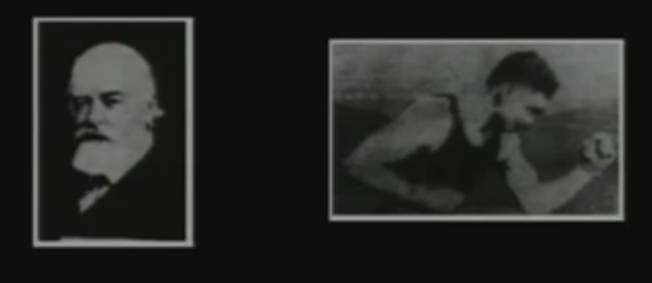
Brief History..
In 1921, the photographic process for picture reproduction was introduced
The receiver; instead of using the telegraphic printer, the digital images or the codes of digital images were perforated on a tape and photographic printing was carried on using those tapes.

Slide 42
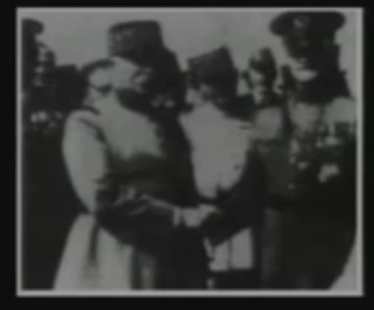
Brief History..
The Bartlane system in 1920’s, was capable of coding 5 distinct brightness levels.
This was increased to 15 levels by 1929.
Here we find an image with 15 different intensity levels and here the quality of this image is better than the quality of the image which was produced by the Bartlane system.

Slide 43
Brief History..
Since 1929, for next 35 years; the researches have paid their attention to improve the image quality or to improve the reproduction quality.
in 1964, these image processing techniques were being used at Jet Propulsion Laboratory to improve the pictures of moon which have been transmitted by ranger 7.
And, we can say that this is the time from where the image processing techniques or the digital image processing techniques has got a boost and this is considered to be the basis of modern image processing techniques.

Slide 44
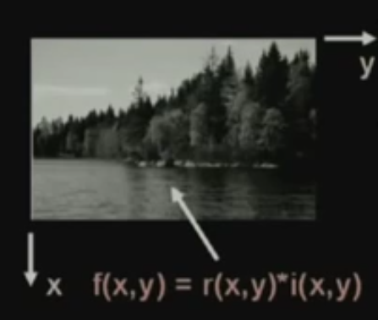
Image representation
At a particular point X Y in the image, conventionally the X coordinate is taken vertically downwards and the Y axis is taken horizontally towards right.
if I look at this image, this image is nothing but a 2 dimensional intensity function which is represented by f (x, y).
f (x, y) is represented by product of 2 terms;
one term is r (x, y)
other term is i (x, y).
r (x, y) is the refractivity of the surface of the corresponding image point from where the light gets reflected
i (x, y), it represents the intensity of the incident light.

Slide 45
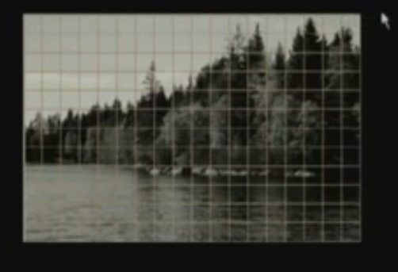
There are infinite number of points with infinite possible intensity values
Take samples of the image on a regular grid.
First level representation of an image in a digital computer is spatial discretization by grids.
once we get these sample values, at every point, the value of sample is again continuous.
So, it can assume any of the infinite possible values
^{For that,} the second operation that we have to do is discretization of the intensity values of different samples: called quantization.

Slide 46
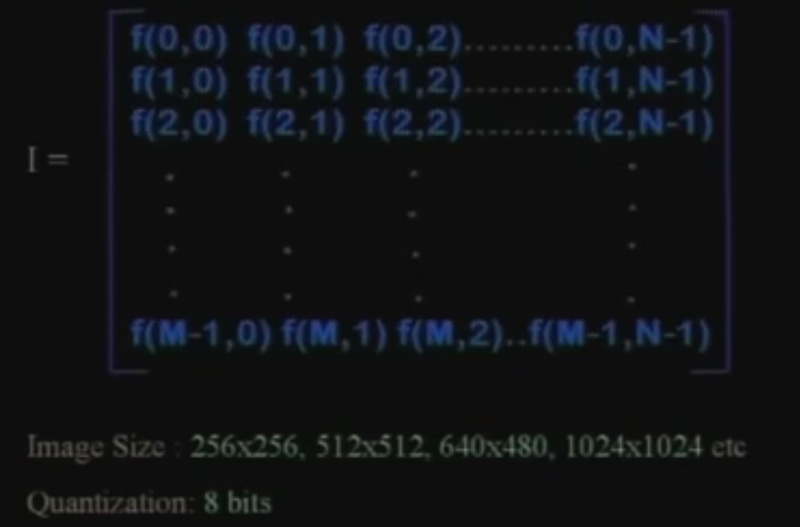
m number of rows and n number of columns
each of these elements in this matrix representation is called a pixel or a pale.

Slide 47
Quantization
Each of this sample values are quantized and typically for image processing applications,
The quantization is done using 8 bits for black and white image
24 bits for color image, there are 3 color planes - red, green and blue.
For each of the planes, if used 8 bits for quantization, then it gives us 24 bits which is used for representation of digital color image.

Slide 48
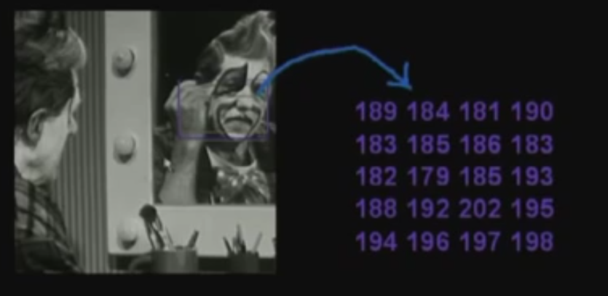
Values of sample

Slide 49
Steps in digital image processing techniques
First step is image acquisition.
The next step processing which are known as pre processing which takes care of removing the noise or enhancement of the contrast and so on.
The third operation is segmentation. That is partitioning an input image into constituent parts of objects. The segmentation is also responsible for extracting the object points from the boundary points.

Slide 50
Steps in digital image processing techniques…
After segmentation, the next step is to extract some description of the image objects which are suitable for further computer processing.
Then we have recognition. By getting the description of the objects; its interpreted or recognized what that object is.
The last step is the knowledge base where the knowledge bases helps for efficient processing as well as inter module cooperation of all the previous processing steps.

Slide 51
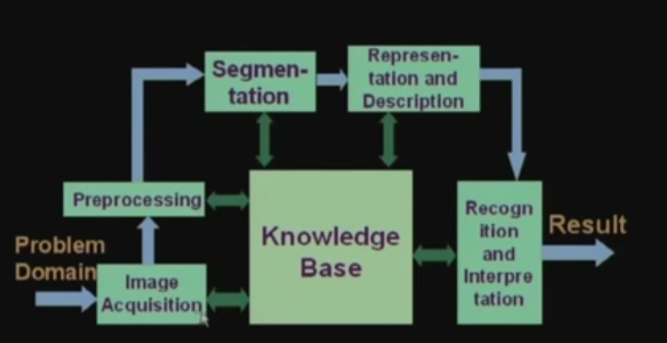
Steps in blocks

Slide 52
References
Prof .P. K. Biswas Department of Electronics and Electrical Communication Engineering Indian Institute of Technology, Kharagpur
Gonzalez R. C. & Woods R.E. (2008). Digital Image Processing. Prentice Hall.
Forsyth, D. A. & Ponce, J. (2011).Computer Vision: A Modern Approach. Pearson Education.

